Slide 1
Interview Question Can we insert or delete the elements after creating an array?
momedaram

Slide 2
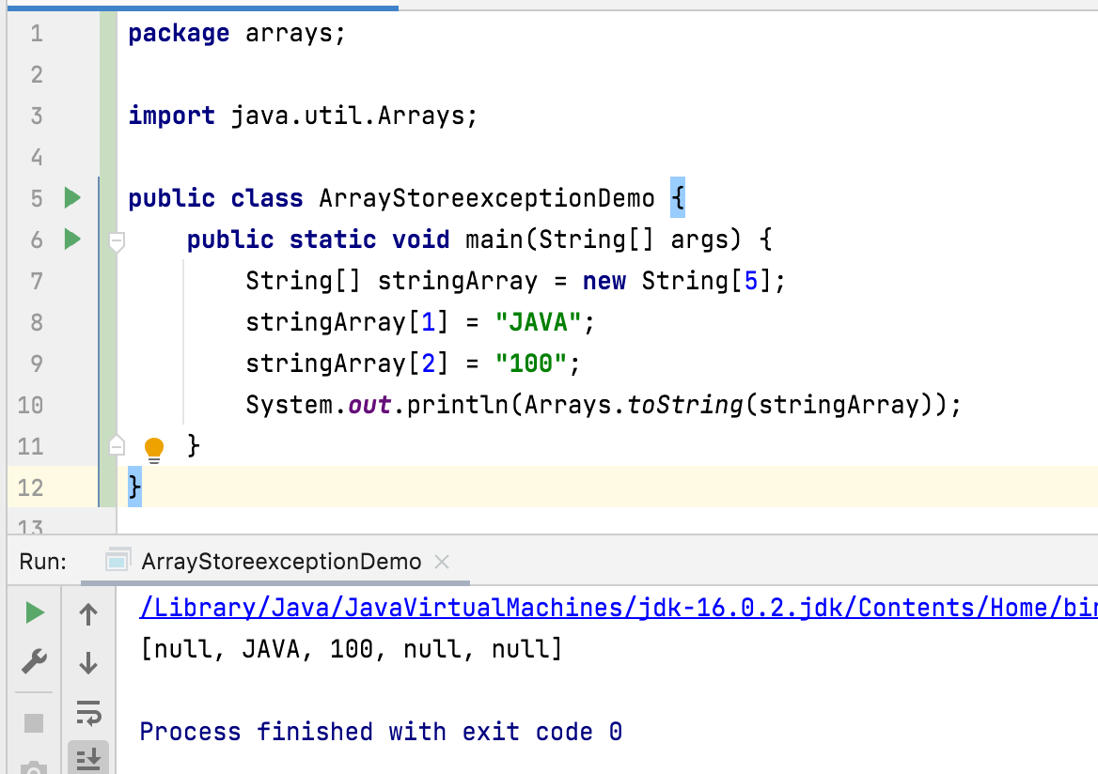
Can we insert or delete the elements after creating an array?
we can not insert or delete the elements after creating an array.
i.e., The Size of the array array is fixed.
Only we can change the value of the elements.

